Slide 1

Chapter 11
Data Link Control
11.<number>
Copyright © The McGraw-Hill Companies, Inc. Permission required for reproduction or display.

Slide 2
11-1 FRAMING
The data link layer needs to pack bits into frames, so that each frame is distinguishable from another. Our postal system practices a type of framing. The simple act of inserting a letter into an envelope separates one piece of information from another; the envelope serves as the delimiter.
Fixed-Size Framing
Variable-Size Framing
11.<number>

Slide 3

Figure 11.1 A frame in a character-oriented protocol
11.<number>

Slide 4

Figure 11.2 Byte stuffing and unstuffing
11.<number>

Slide 5

Note
Byte stuffing is the process of adding 1 extra byte whenever there is a flag or escape character in the text.
11.<number>

Slide 6

Figure 11.3 A frame in a bit-oriented protocol
11.<number>

Slide 7
Note
Bit stuffing is the process of adding one extra 0 whenever five consecutive 1s follow a 0 in the data, so that the receiver does not mistake
the pattern 0111110 for a flag.
11.<number>

Slide 8

Figure 11.4 Bit stuffing and unstuffing
11.<number>

Slide 9
11-2 FLOW AND ERROR CONTROL
The most important responsibilities of the data link layer are flow control and error control. Collectively, these functions are known as data link control.
Topics discussed in this section:
Flow Control
Error Control
11.<number>

Slide 10
Note
Flow control refers to a set of procedures used to restrict the amount of data
that the sender can send before
waiting for acknowledgment.
When receiver’s processing time is greater than sender’s transmission time(receiver is slower)
Not to overwhelm the receiver
11.<number>

Slide 11
Note
Error control in the data link layer is based on automatic repeat request, which is retransmission of data in case of damaged or lost frames.
11.<number>

Slide 12
11-3 PROTOCOLS
Now let us see how the data link layer can combine framing, flow control, and error control to achieve the delivery of data from one node to another. The protocols are normally implemented in software by using one of the common programming languages. To make the discussions programming language-free, pseudocode version of each protocol that concentrates mostly on the procedure instead of delving into the details of language rules are given in the book. Refer the book for more detail. Here, let’s have the conceptual level presentation with many diagrams for easy understanding of working of the protocols.
11.<number>

Slide 13

Figure 11.5 Taxonomy of protocols discussed in this chapter
11.<number>

Slide 14
11-4 NOISELESS CHANNELS
Let us first assume we have an ideal channel in which no frames are lost, duplicated, or corrupted.
- It is not in real time. We see it here just to understand the basics.
- We introduce two protocols for this type of channel.
Simplest Protocol
Stop-and-Wait Protocol
11.<number>

Slide 15

Figure 11.6 The design of the simplest protocol with no flow or error control
11.<number>

Slide 16
Example 11.1
Figure 11.7 shows an example of communication using this protocol. It is very simple. The sender sends a sequence of frames without even thinking about the receiver.
The height of the box defines the transmission time difference between the first bit and the last bit in the frame.
11.<number>

Slide 17

Figure 11.7 Flow diagram for Example 11.1 – No ACK from receiver
11.<number>

Slide 18
Stop and Wait Flow Control Protocol
If sender is faster than receiver?
  Overflow of frames / Discarding frames
  Denial of Service
So, feedback from receiver (ACK) is introduced. i.e. Okay to go ahead / send
  Half duplex in nature (Data or ACK, not both)
11.<number>

Slide 19

Figure 11.8 Design of Stop-and-Wait Protocol
11.<number>

Slide 20
Example 11.2
Figure 11.9 shows an example of communication using this protocol. It is still very simple. The sender sends one frame and waits for feedback from the receiver. When the ACK arrives, the sender sends the next frame.
Note: We consider here only unidirectional flow. i.e. Data frames from sender(A) to receiver(B). But, in real situation there may be bidirectional flow. i.e. Data exchange on both sides where ACK are piggybacked to data frames.
11.<number>

Slide 21
Note the following in the next figure!
Unidirectional flow
Half duplexing
Propagation time
Transmission time
Waiting time for ACK
  Round trip delay
11.<number>

Slide 22

Figure 11.9 Flow diagram for Example 11.2
11.<number>

Slide 23
Sliding window protocols
Sliding window protocols are data link layer protocols for better link utilization/efficiency
In this protocol, multiple frames can be sent by a sender at a time before receiving an acknowledgment from the receiver.
The term sliding window refers to the imaginary boxes to hold frames.
Sliding window method is also known as windowing
11.<number>

Slide 24
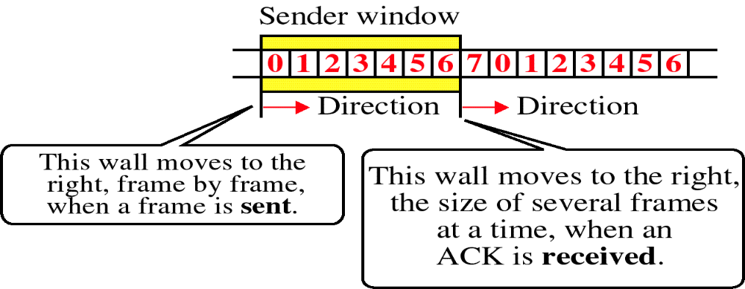
Sender Sliding Window
- The size of the sending window determines the sequence number of the outbound frames.
If the sequence number of the frames is an m-bit field in the protocol, then the range of sequence numbers that can be assigned is 0 to 2^{m}−1. (Say m=3, seq. no. are from 0 to 7)
- The sequence numbers are numbered as modulo- 2^{m}. (0 to 7, i.e. no.s less than 8)
- The max. size of the sending window is 2^{m}. (Determined by the capability of the receiver)
For example, if the sending window size is 7, then the sequence numbers will be 0, 1, 2, 3, 4, 5, 6, 7, 0, 1, 2, 3, 4, 5, 6, 7, 0, 1, and so on. The number of bits in the sequence number is 3 to generate the binary sequence 000, 001, 010, 011,100,100,101,110,111.

Slide 25
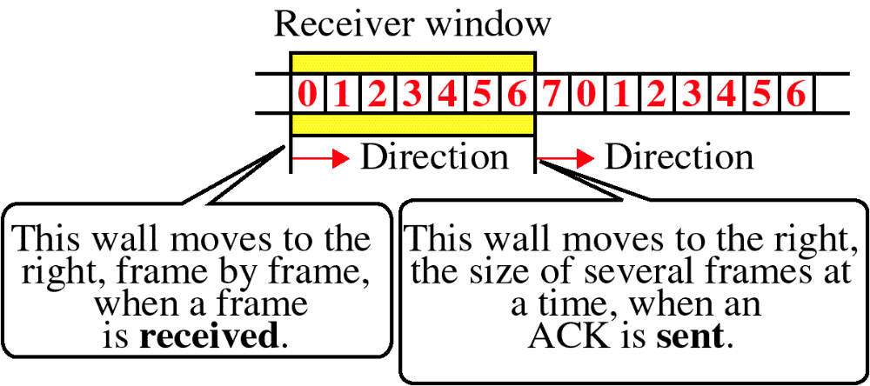
Receiver Sliding Window
The size of the receiving window is the maximum number of frames that the receiver can accept at a time.
It determines the maximum number of frames that the sender can send before receiving acknowledgment.

Slide 26
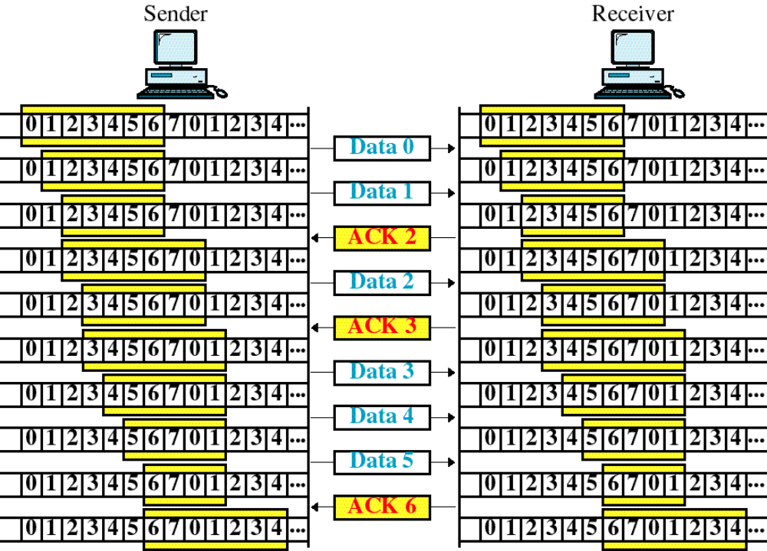
Sliding Window Example

Slide 27
Sliding Window Flow Control protocol (in comparison with Stop & Wait protocol)
Multiple frames sending before receiving ACK (one frame only)
Max. window size is 2^{m} (one only)
Sequence no. ranges from 0 to 2^{m}−1 (zero and one only)
Full duplex in nature (Half duplex)
High link utilization/efficiency (Low due to waiting for ACK for every frame transmission)
Note: In both protocols only flow control take place. No question of damaged/lost frame or time out or retransmission as we assumed “Noiseless” channel. Hence cumulative ACK helps sliding of window protocol to improve link efficiency.
11.<number>

Slide 28
Difference between Stop and Wait and Sliding Window Protocol
Parameter | Stop and Wait Protocol | Sliding Window
Mechanism | In Stop and Wait protocol, the sender sends a single frame and waits for an acknowledgment from the receiver. | In Sliding window protocol, the sender sends multiple frames at a time and retransmits the damaged frames.
Window Size | 1 | Varies from 1 to 2^{n}, where n is the number of bits allotted in the protocol to represent the sequence number
Sorting | Sorting of frames is not needed. | Sorting of frames helps to increase the efficiency of the protocol.
Efficiency | Stop and Wait protocol efficiency is formulated as 1/(1+2a) where a is a ratio of propagation delay to the transmission delay. | Sliding Window protocol efficiency is formulated as N/(1+2a) where N is no. of window frames and a is a ratio of propagation delay to the transmission delay.
Duplex | Stop and Wait protocol is half-duplex in nature. | Sliding Window protocol is full-duplex in nature.

Slide 29
Although the Stop-and-Wait and Sliding Window Protocols give us an idea of how to add flow control to their predecessor (simplest protocol), noiseless channels are nonexistent. We discuss three protocols in this section that use error control. These protocols are timer based to handle retransmission.
- Redundancy is to detect corrupted frames
Seq. no. is to handle lost and duplicated frames.
Corrupted and duplicated frames are discarded
Sender keeps copy of frames and run timers to do retransmission
- Receiver keeps silence (not sending ACK)
- Sending NACK (NAK) is to minimize delay in Selective Repeat ARQ
11-5 NOISY CHANNELS
Stop-and-Wait Automatic Repeat Request
Go-Back-N Automatic Repeat Request
Selective Repeat Automatic Repeat Request
11.<number>

Slide 30
Note
Error correction in Stop-and-Wait ARQ is done by keeping a copy of the sent frame and retransmitting of the frame when the timer expires.
11.<number>

Slide 31
Note
In Stop-and-Wait ARQ, we use sequence numbers to number the frames.
The sequence numbers are based on modulo-2 arithmetic.
11.<number>

Slide 32
Note
In Stop-and-Wait ARQ, the acknowledgment number always announces in modulo-2 arithmetic the sequence number of the next frame expected.
11.<number>

Slide 33

Figure 11.10 Design of the Stop-and-Wait ARQ Protocol
11.<number>

Slide 34
Example 11.3
Figure 11.11 shows an example of Stop-and-Wait ARQ. Frame 0 is sent and acknowledged. Frame 1 is lost and resent after the time-out. The resent frame 1 is acknowledged and the timer stops. Frame 0 is sent and acknowledged, but the acknowledgment is lost. The sender has no idea if the frame or the acknowledgment is lost, so after the time-out, it resends frame 0, which is acknowledged.
11.<number>

Slide 35

Figure 11.11 Flow diagram for Example 11.3
11.<number>

Slide 36
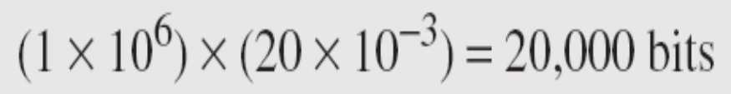
Example 11.4
Assume that, in a Stop-and-Wait ARQ system, the bandwidth of the line is 1 Mbps, and 1 bit takes 20 ms to make a round trip. What is the bandwidth-delay product? If the system data frames are 1000 bits in length, what is the utilization percentage of the link?
Solution
The bandwidth-delay product (Thick & long pipe : a measure of link capacity(volume of pipe) in bits) is
11.<number>

Slide 37
Example 11.4 (continued)
The system can send 20,000 bits during the time it takes for the data to go from the sender to the receiver and then back again. However, the system sends only 1000 bits. We can say that the link utilization is only 1000/20,000, or 5 percent. For this reason, for a link with a high bandwidth or long delay, the use of Stop-and-Wait ARQ wastes the capacity of the link.
11.<number>

Slide 38
Example 11.5
What is the utilization percentage of the link in Example 11.4 if we have a protocol that can send up to 15 frames before stopping and worrying about the acknowledgments?
Solution
The bandwidth-delay product is still 20,000 bits. The system can send up to 15 frames or 15,000 bits during a round trip. This means the utilization is 15,000/20,000, or 75 percent. Of course, if there are damaged frames, the utilization percentage is much less because frames have to be resent.
11.<number>

Slide 39
Note
In the Go-Back-N Protocol, the sequence numbers are modulo 2^{m},
where m is the size of the sequence number field in bits.
11.<number>

Slide 40

Figure 11.12 Send window for Go-Back-N ARQ
11.<number>

Slide 41
Note
The send window is an abstract concept defining an imaginary box of size 2^{m} − 1 with three variables: Sf, Sn, and S_{size}.
11.<number>

Slide 42
Note
The send window can slide one
or more slots when a valid acknowledgment arrives.
11.<number>

Slide 43

Figure 11.13 Receive window for Go-Back-N ARQ
11.<number>

Slide 44
Note
The receive window is an abstract concept defining an imaginary box
of size 1 with one single variable R_{n}.
The window slides
when a correct frame has arrived; sliding occurs one slot at a time.
11.<number>

Slide 45
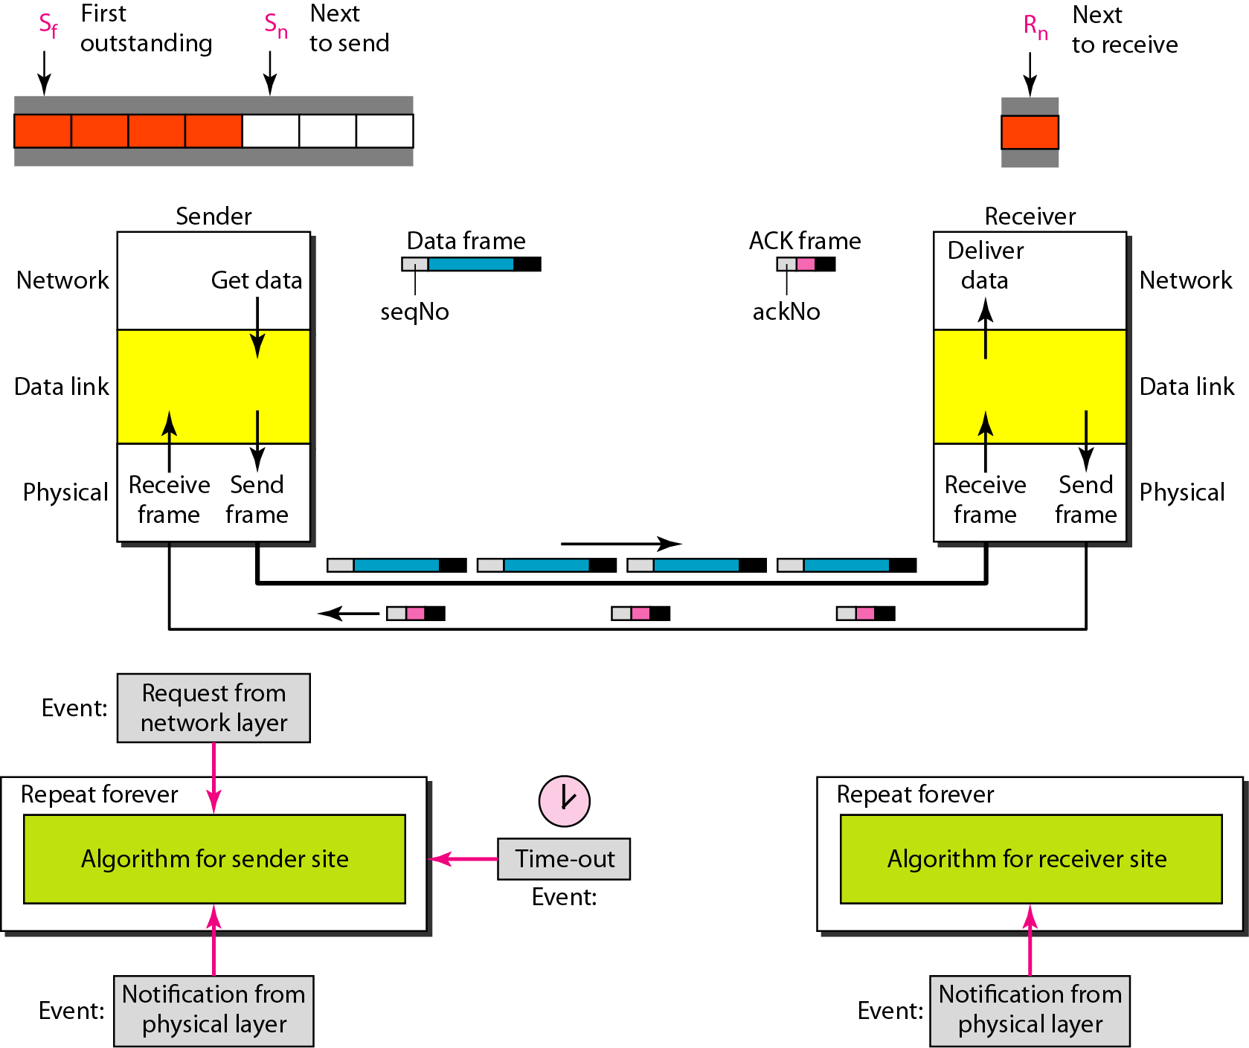
Figure 11.14 Design of Go-Back-N ARQ
11.<number>

Slide 46

Figure 11.15 Window size for Go-Back-N ARQ
11.<number>

Slide 47
Note
In Go-Back-N ARQ, the size of the send window must be less than 2^{m};
the size of the receiver window
is always 1.
11.<number>

Slide 48
Example 11.6
Figure 11.16 shows an example of Go-Back-N. This is an example of a case where the forward channel is reliable, but the reverse is not. No data frames are lost, but some ACKs are delayed and one is lost. The example also shows how cumulative acknowledgments can help if acknowledgments are delayed or lost. After initialization, there are seven sender events. Request events are triggered by data from the network layer; arrival events are triggered by acknowledgments from the physical layer. There is no time-out event here because all outstanding frames are acknowledged before the timer expires. Note that although ACK 2 is lost, ACK 3 serves as both ACK 2 and ACK 3.
11.<number>

Slide 49

Figure 11.16 Flow diagram for Example 11.6
11.<number>

Slide 50
Example 11.7
Figure 11.17 shows what happens when a frame is lost. Frames 0, 1, 2, and 3 are sent. However, frame 1 is lost. The receiver receives frames 2 and 3, but they are discarded because they are received out of order. The sender receives no acknowledgment about frames 1, 2, or 3. Its timer finally expires. The sender sends all outstanding frames (1, 2, and 3) because it does not know what is wrong. Note that the resending of frames 1, 2, and 3 is the response to one single event. When the sender is responding to this event, it cannot accept the triggering of other events. This means that when ACK 2 arrives, the sender is still busy with sending frame 3.
11.<number>

Slide 51
Example 11.7 (continued)
The physical layer must wait until this event is completed and the data link layer goes back to its sleeping state. We have shown a vertical line to indicate the delay. It is the same story with ACK 3; but when ACK 3 arrives, the sender is busy responding to ACK 2. It happens again when ACK 4 arrives. Note that before the second timer expires, all outstanding frames have been sent and the timer is stopped.
11.<number>

Slide 52

Figure 11.17 Flow diagram for Example 11.7
11.<number>

Slide 53
Note
Stop-and-Wait ARQ is a special case of Go-Back-N ARQ in which the size of the send window is 1.
11.<number>

Slide 54

Figure 11.18 Send window for Selective Repeat ARQ
11.<number>

Slide 55

Figure 11.19 Receive window for Selective Repeat ARQ
11.<number>

Slide 56
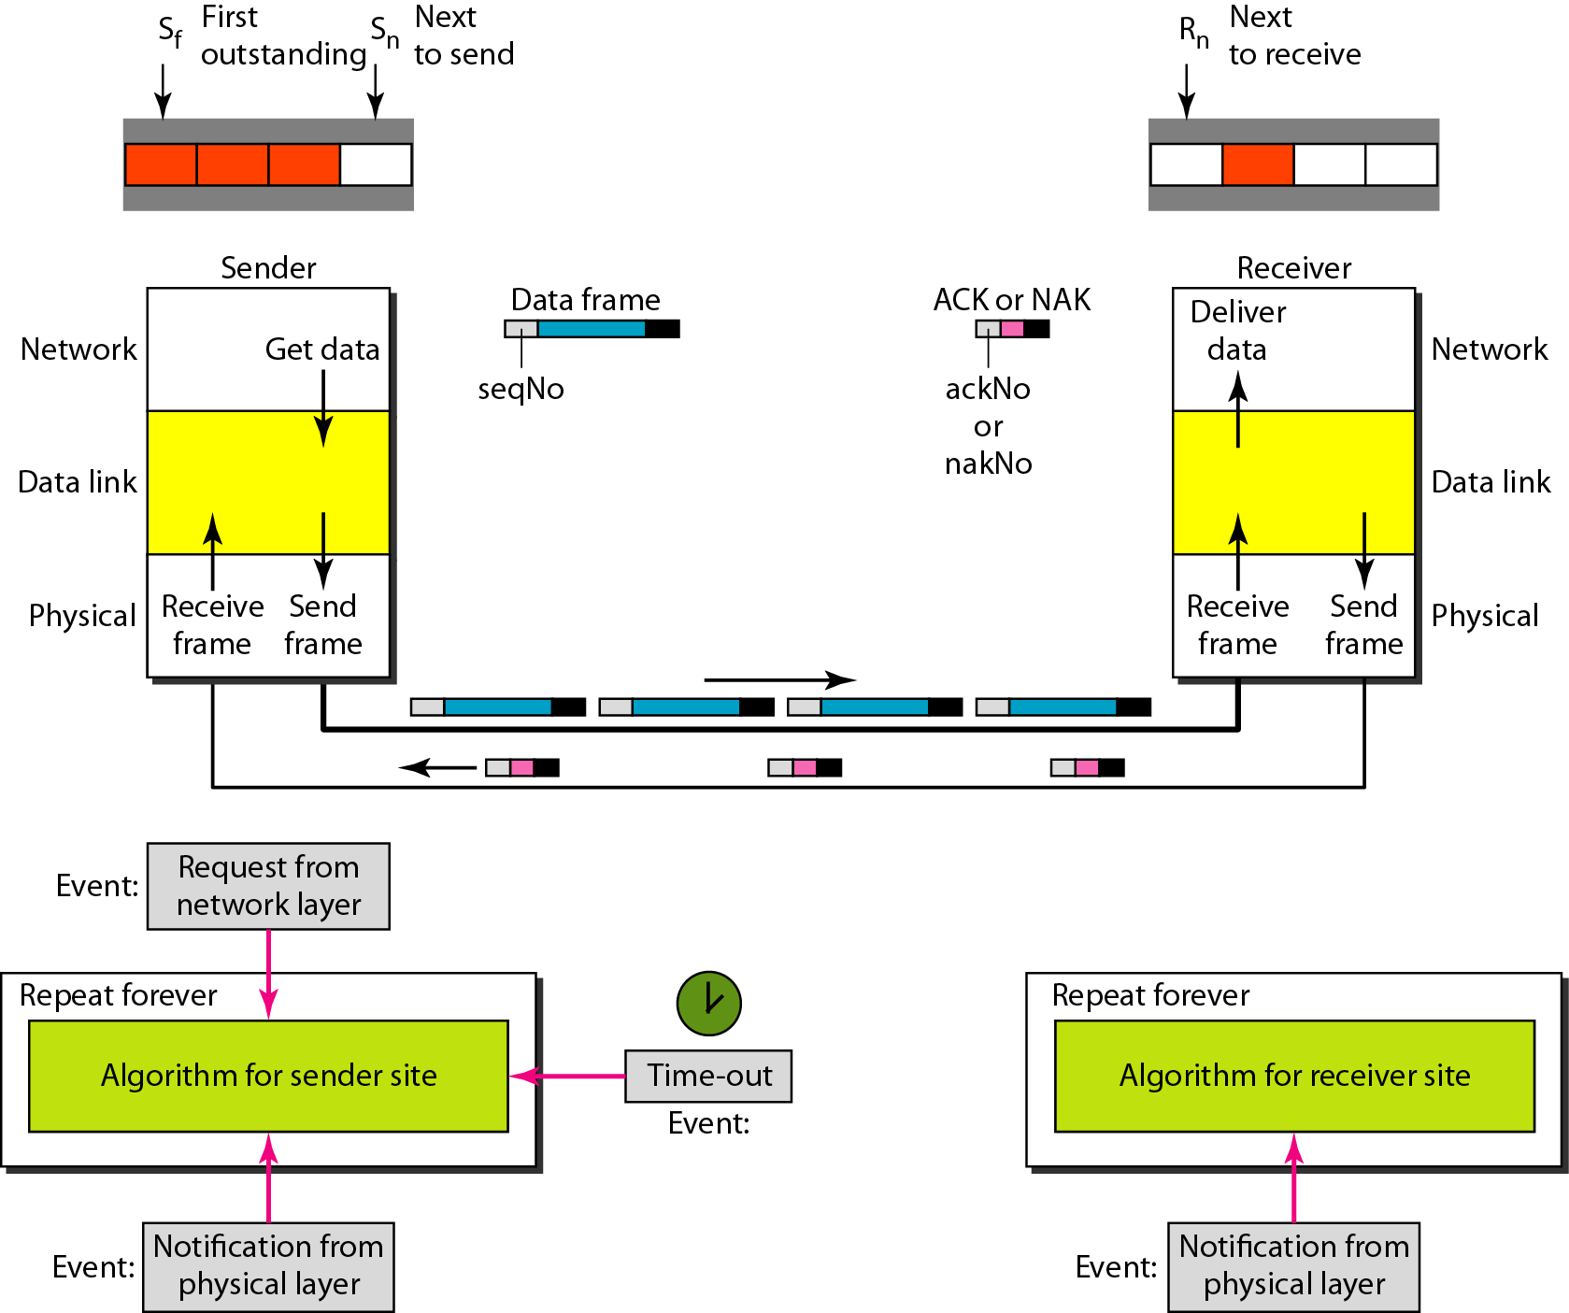
Figure 11.20 Design of Selective Repeat ARQ
11.<number>

Slide 57

Figure 11.21 Selective Repeat ARQ, window size
11.<number>

Slide 58
Note
In Selective Repeat ARQ, the size of the sender and receiver window
must be at most one-half of 2^{m}.
11.<number>

Slide 59

Figure 11.22 Delivery of data in Selective Repeat ARQ
11.<number>

Slide 60
Example 11.8
This example is similar to Example 11.3 in which frame 1 is lost. We show how Selective Repeat behaves in this case. Figure 11.23 shows the situation. One main difference is the number of timers. Here, each frame sent or resent needs a timer, which means that the timers need to be numbered (0, 1, 2, and 3). The timer for frame 0 starts at the first request, but stops when the ACK for this frame arrives. The timer for frame 1 starts at the second request, restarts when a NAK arrives, and finally stops when the last ACK arrives. The other two timers start when the corresponding frames are sent and stop at the last arrival event.
11.<number>

Slide 61
Example 11.8 (continued)
At the receiver site we need to distinguish between the acceptance of a frame and its delivery to the network layer. At the second arrival, frame 2 arrives and is stored and marked, but it cannot be delivered because frame 1 is missing. At the next arrival, frame 3 arrives and is marked and stored, but still none of the frames can be delivered. Only at the last arrival, when finally a copy of frame 1 arrives, can frames 1, 2, and 3 be delivered to the network layer. There are two conditions for the delivery of frames to the network layer: First, a set of consecutive frames must have arrived. Second, the set starts from the beginning of the window.
11.<number>

Slide 62
Example 11.8 (continued)
Another important point is that a NAK is sent after the second arrival, but not after the third, although both situations look the same. The reason is that the protocol does not want to crowd the network with unnecessary NAKs and unnecessary resent frames. The second NAK would still be NAK1 to inform the sender to resend frame 1 again; this has already been done. The first NAK sent is remembered (using the nakSent variable) and is not sent again until the frame slides. A NAK is sent once for each window position and defines the first slot in the window.
11.<number>

Slide 63
Example 11.8 (continued)
The next point is about the ACKs. Notice that only two ACKs are sent here. The first one acknowledges only the first frame; the second one acknowledges three frames. In Selective Repeat, ACKs are sent when data are delivered to the network layer. If the data belonging to n frames are delivered in one shot, only one ACK is sent for all of them.
11.<number>

Slide 64

Figure 11.23 Flow diagram for Example 11.8
11.<number>

Slide 65
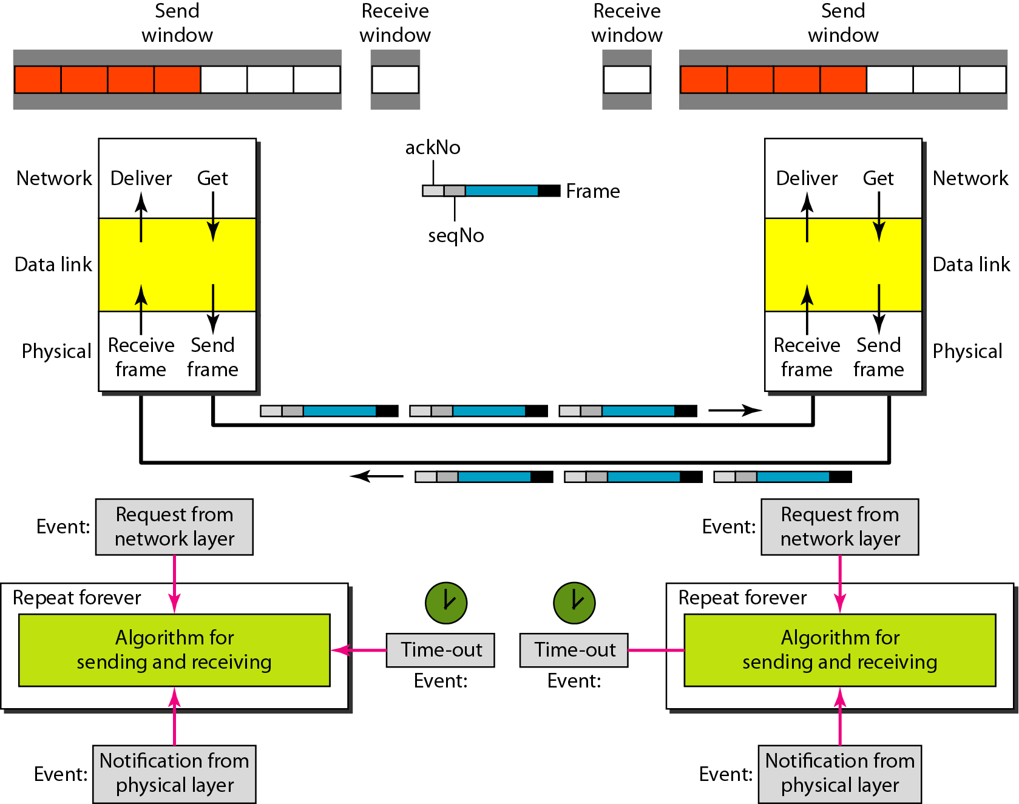
Figure 11.24 Design of piggybacking in Go-Back-N ARQ
11.<number>

Slide 66
Comparison of Stop and Wait, Go-Back-n and Selective Reject ARQ Protocols
Parameter | Stop and Wait | Go-Back-n | Selective Reject
Sender window size | Sender window size is 1. | Sender window size is less than 2^{m}−1. | Sender window size is equal to 2^{m-1}.
Receiver Window size | Receiver window size is 1 | Receiver window size is 1. | Receiver window size is 2^{m-1} .
Acknowledgement Type | Individual | Cumulative | Cumulative
Supported Order | Ordered delivery needed at receiver end | In-order delivery only are accepted at receiver end | Out-of-order deliveries also can be accepted at receiver end.
Re-transmission | in case of packet drop, number of re-transmission is 1 | in case of packet drop, numbers of re-transmissions are N | in case of packet drop, number of re-transmission is 1
Buffer Requirement / Receiver complexity / Link utilization | Less | Less / Moderate | More (due to re-ordering of packets)

